Slide 1
Smart Data
Sales Training
Amsterdam, December 2020
@fikri.firat
@sebastiaan
#smart-data
#support-data
INTERNAL USE ONLY
Notes:
why - enable you guys to understand what why and how to sell
but also - to make you able to prep demos (while we dont have a se)
some of you more advanced - we’ll share this later, together with a battlecard, feel free to step out
we did this training before - this one is quite different, richer, very focused on the hands on again, hope you brought your material
it’s a training, not a presentation - please do ask questions as we go

Slide 2
Smart Data Sales Training Agenda
Where we are
What does AI mean for our customers?
How to Win

Slide 3
“We enable businesses to talk to their customers the same way they talk to their friends.”
Person
Contact
Interactions
Knowledge

Slide 4
Brief History of our AI platform
Virtual Assistants, Smart Process Automation
Act
Train
Simple Chatbot Features
Analyse
Understand
First customer-facing feature
Knowledge
First successful internal project
Language Recognition
Sifty
Internal Win
Simple Starts
Weak AI
Strong AI

Slide 5
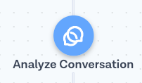
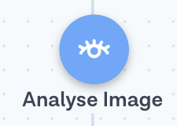
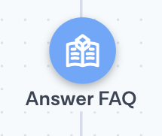
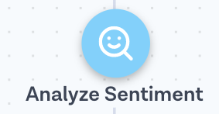
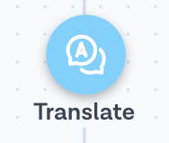
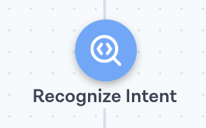
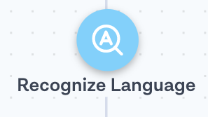
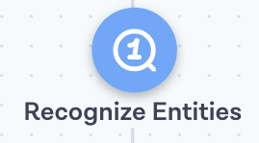
Smart Data Internal Sales Key features
Automation
Routing & Analytics
Beta
Beta
Predict user's sentiment based on messages
Perform NLP-based analysis on full conversation to automate data-driven decisions
Extract data from images such as QR codes, bar codes or text
New
Automate frequently asked questions
Intelligent Virtual Assistants
Translate messages from one language to another
Automate form-based processes by extracting normalized data from messages
Understand what users are trying to do
Detect language of the message

Slide 6
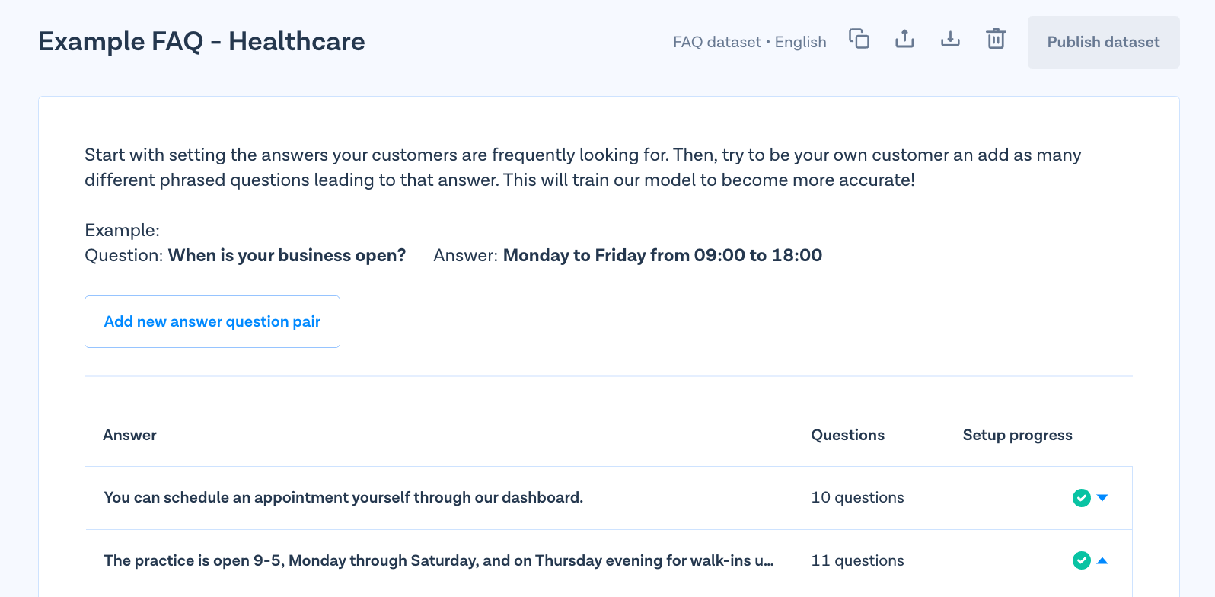
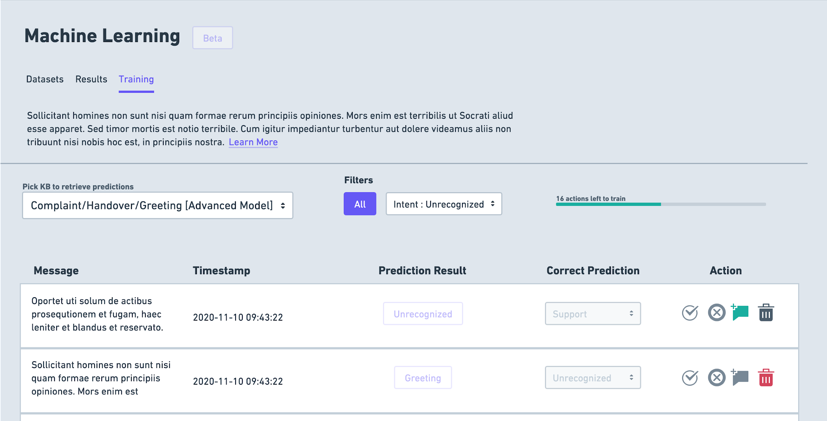
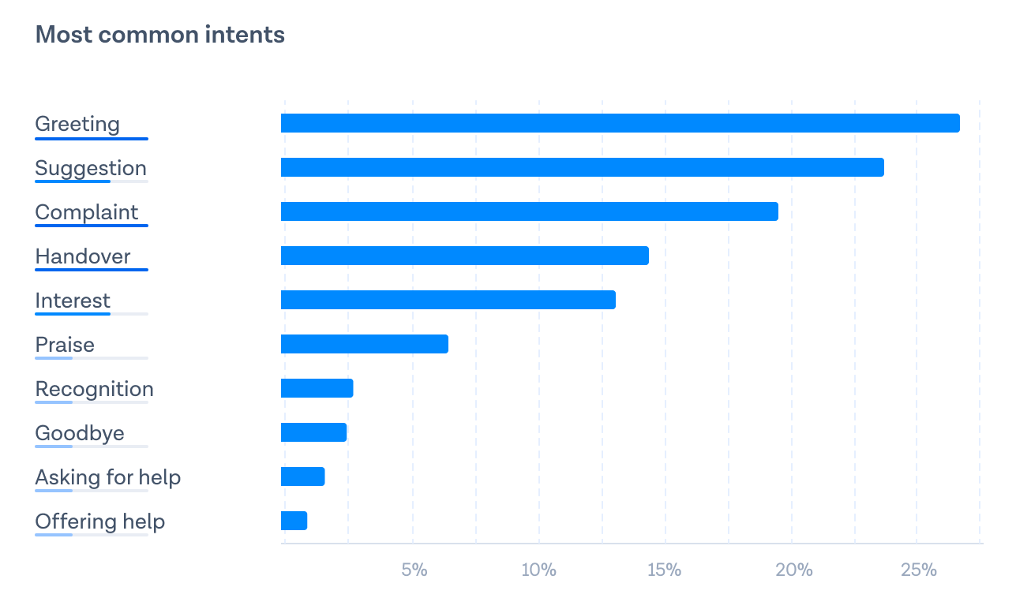
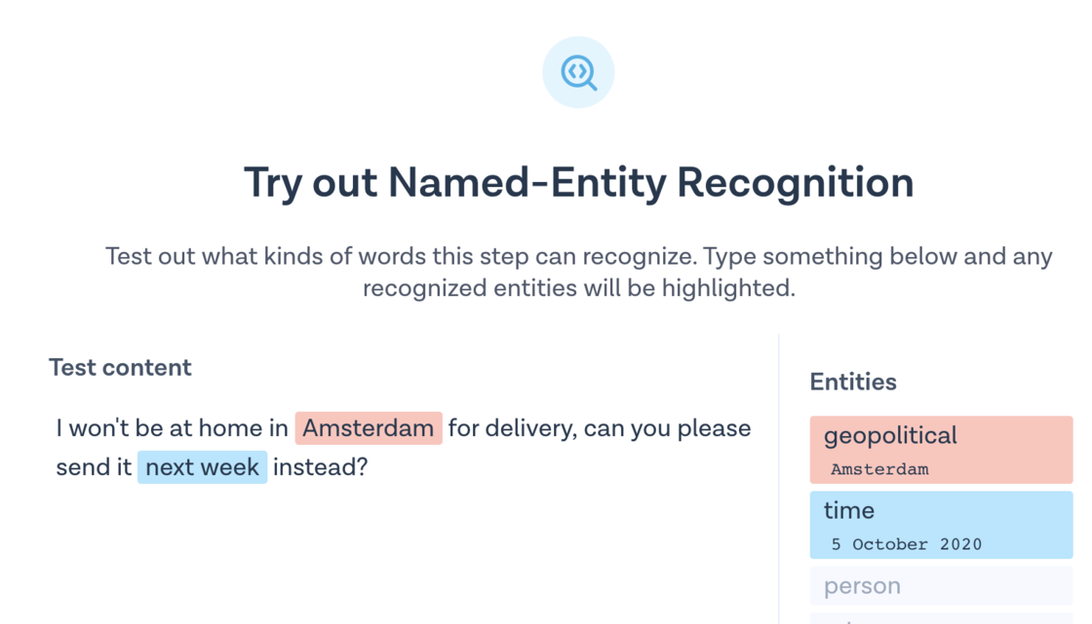
Smart Data Internal Sales Key tools
Knowledge Manager Manage custom datasets for classifying messages and phrases
Insights (soon) Uncover key insights on Knowledge around usage and performance
Learning Improve prediction accuracy through in-context and seamless data labeling
Beta
New
Smart Reports Receive actionable results based on activated AI services through e-mail
Inbox Automations One-click activation of AI features on Flows connected to Inbox
Test/Demo Views Easily test AI-based services within Flow Builder & Knowledge Manager
New

Slide 7
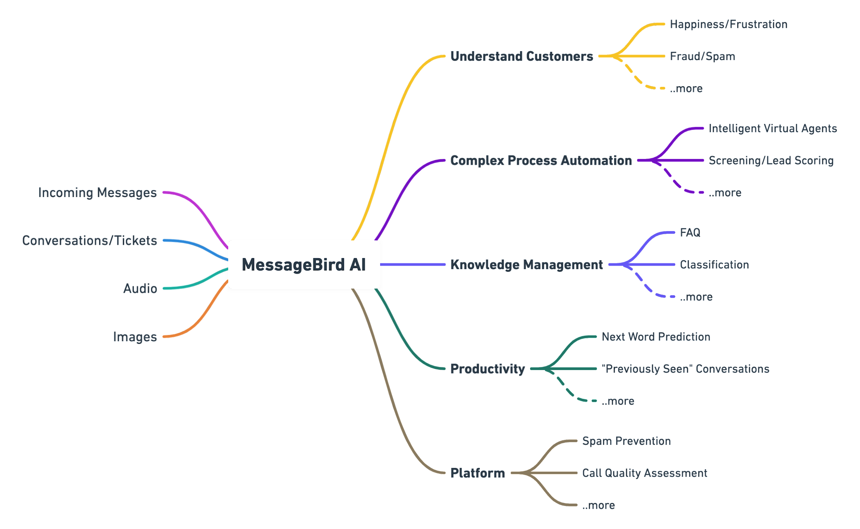
Smart Data Internal Sales How Does it Work?
Build simpler solutions to complex problems using NLP + custom models trained on messages & conversations.
As add-on features with MB platform products such as Inbox & Flow Builder.

Slide 8
Smart Data Internal Sales What does AI mean for our customers?
Some Key Results from Live Usage (Source Data)
Improved ROI
Customers using AI steps achieve +2x better auto-resolution rates than those who don’t.
41% average deflection rate on AI customers vs. 18% for non-AI
AI users deflect +5x more tickets on average
8.6K automated conversations/AI customer vs. 1.6K/non-AI customer
Improved Value extracted from MB Platform
Customers using AI steps tend to build significantly more complex flows and are able to see more value from MB platform overall
AI-enabled flows executed 16 steps per invocation vs. just 5 steps for non-AI flows.

Slide 9
Smart Data Internal Sales What does AI mean for our customers?
Deflection-First Flows
NLP-based Conditions
IVAs
Process Automation
50-99%
3
Hybrid Flows
NLP + Keyword Conditions
Data Extraction & Validation
2
20-50%
Simple Flows
Menu-Based Chatbots
Keyword-based Conditions
1
0-20%
Addressable Automation Cases

Slide 10
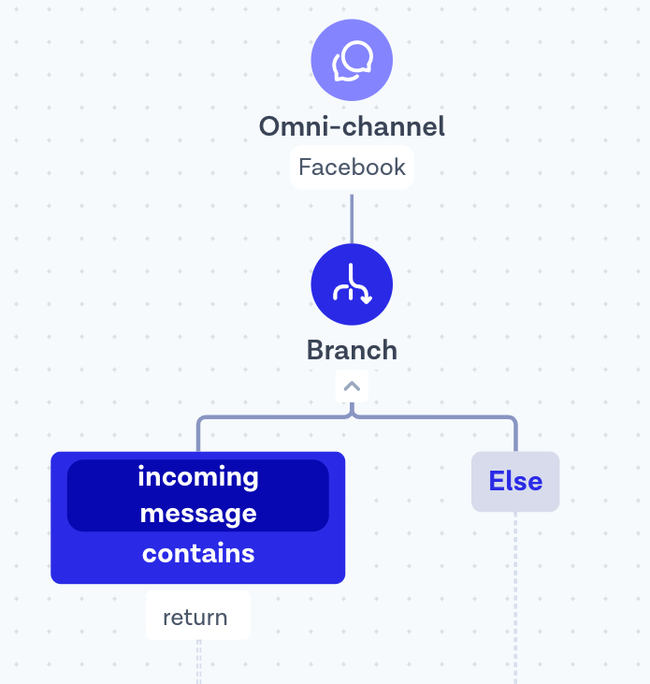
Smart Data Internal Sales What does AI mean for our customers?
I want to return an item
What's your refunds & exchange policy?
How can i cancel my order? My sneakers didn't fit!
Not Captured
Alternate phrases
Typos
Different Languages
Unknown Cases
Captured
Known Phrases
Simple Keyword Condition for Returns

Slide 11
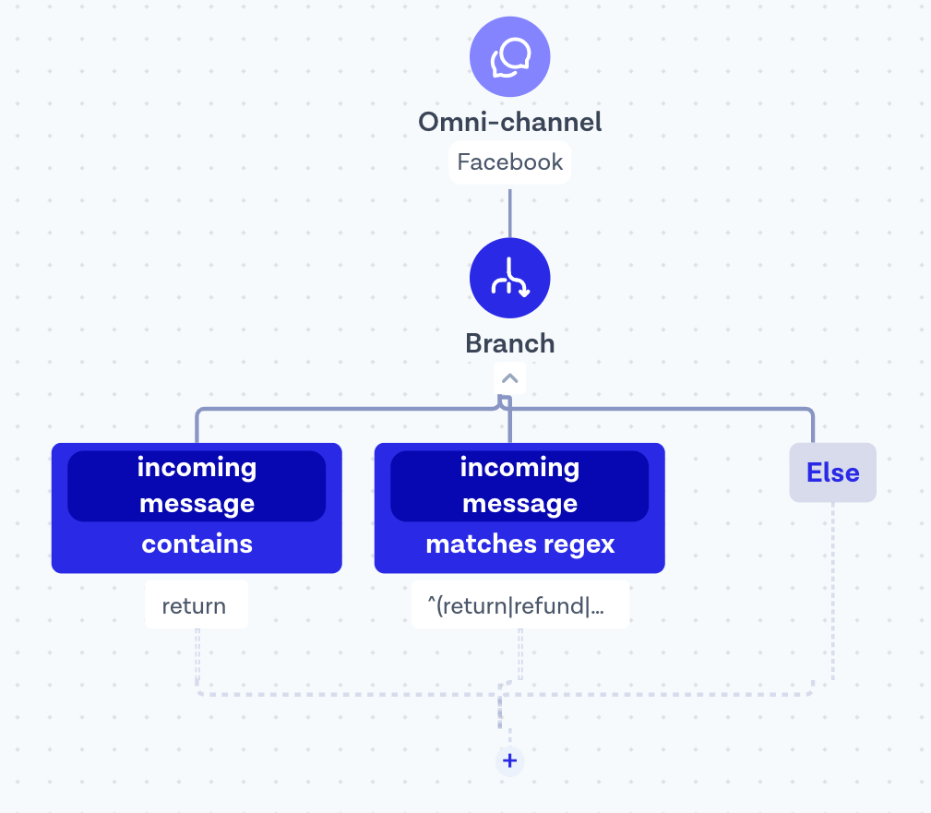
Smart Data Internal Sales What does AI mean for our customers?
I want to return an item
Typo
How can i retrn an item?
What's your refunds & exchange policy?
Language
hoe kan ik mijn bestelling retourneren?
How can i cancel my order? My sneakers didn't fit!
Keywords
My payback still hasn't arrived!!!11!!1
Not Captured
Alternate phrases
Typos
Different Languages
Unknown Cases
Captured
Known Phrases
Known Alternate Phrases
Improved Condition with RegExp for Returns

Slide 12
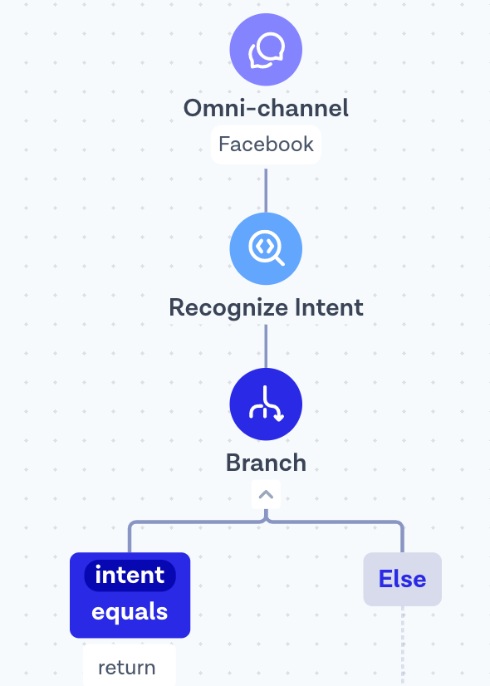
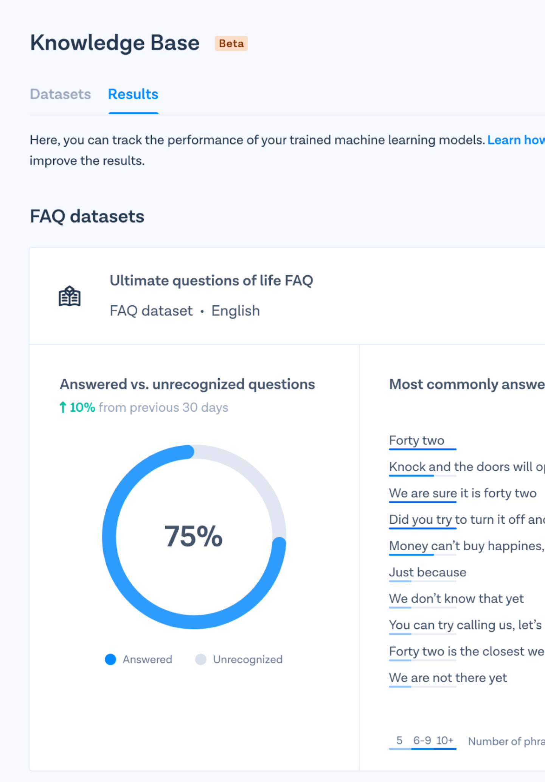
Smart Data Internal Sales What does AI mean for our customers?
I want to return an item
What's your refunds & exchange policy?
How can i cancel my order? My sneakers didn't fit!
Typo
How can i retrn an item?
Language
hoe kan ik mijn bestelling retourneren?
Keywords
My payback still hasn't arrived!!!11!!1
Intent-Based Routing

Slide 13
Smart Data Internal Sales What does AI mean for our customers?
FLOW BUILDER
Simple Logic
Logs & Heatmap
Triggers
Integrations
AI PLATFORM
NLP Logic
Knowledge Manager
Dataset Insights
Prediction Feedbacks
Active Learning
BASIC ROUTING
Keyword or Rule-based
Custom Logic by Customer
SMART ROUTING
Knowledge-Based
AI Logic by Customer
Reduced Cost
of Ownership
BASIC DEFLECTION
Business Hours
Welcome Message
Custom Logic by Customer
+
SMART DEFLECTION
FAQ Automation
IVAs
AI Logic by Customer
=
Reduced
Developer Overhead
BASIC OBSERVABILITY
Invocation success rate
Flow Heatmap
SMART OBSERVABILITY
Deflection Rate
Distribution of Intents/Answers
Capture unknown cases
Prediction Feedbacks & Training
Improved Journey Observability

Slide 14
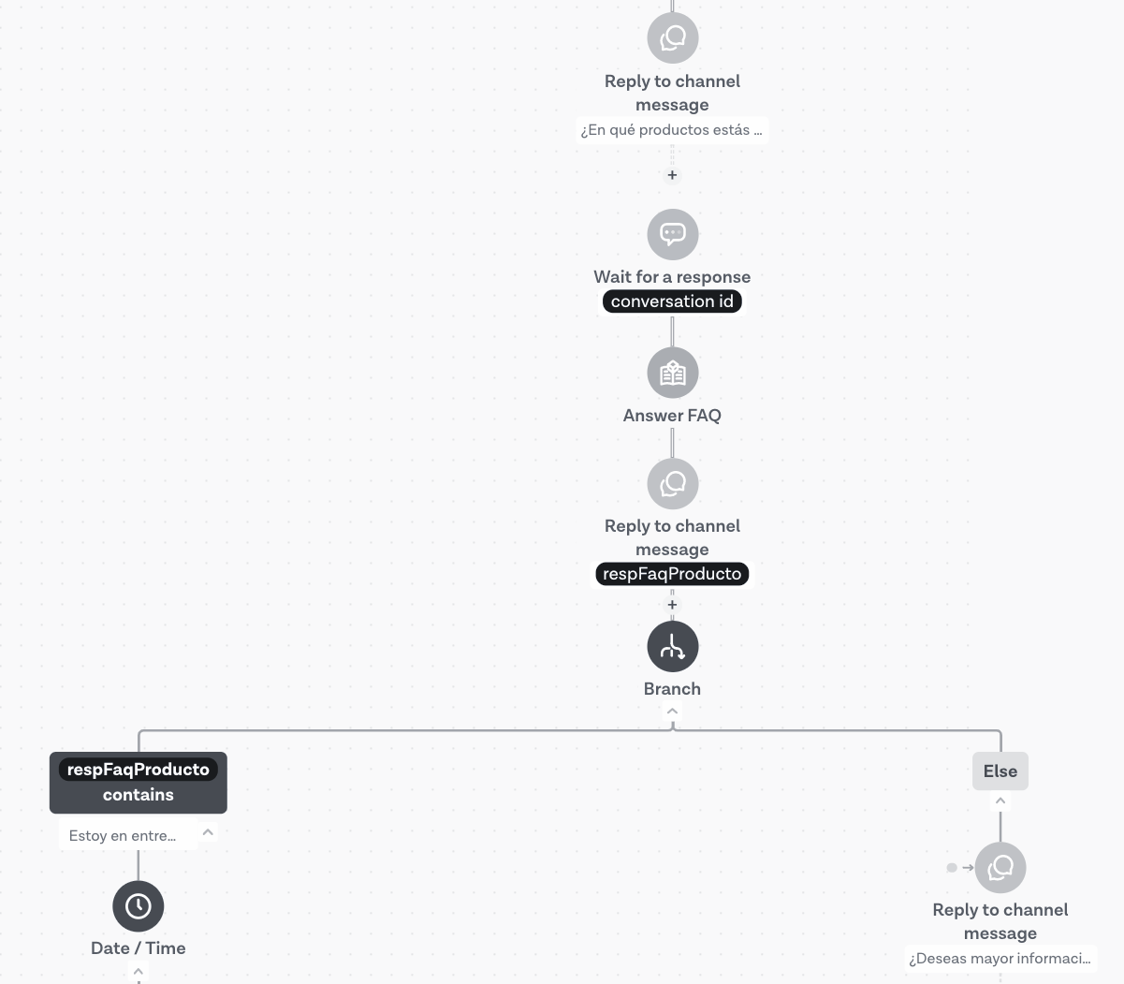
Smart Data Internal Sales Customer Spotlight - FAQ
Diceltesca
(MT: #7763549 / MB: #6747912)
Automates commonly asked questions in their flow by Answer FAQ step
82%
Of all incoming requests deflected using NLP
62%
Of all questions answered using the FAQ dataset

Slide 15
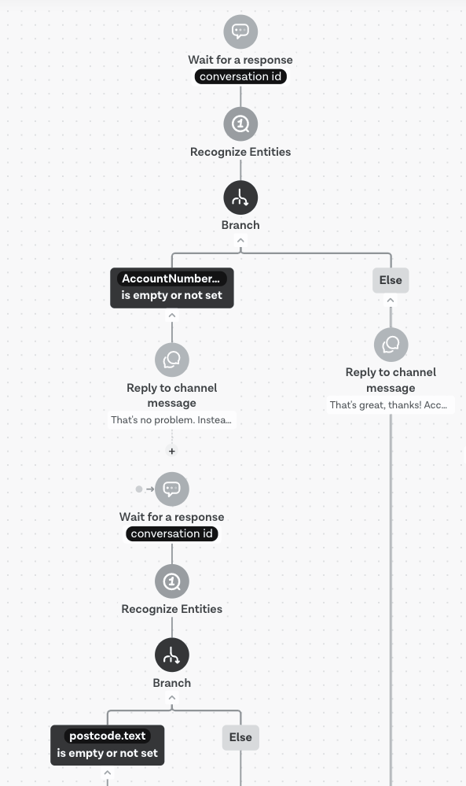
Smart Data Internal Sales Customer Spotlight - Entity Recognition
SSE
(MT: #8876879 / MB: #7875322)
Lead Qualification by validating user’s account number and post code.
See drop rates/dropping users via Flow Logs and Heatmap
Improved process visibility
Improved agent efficiency

Slide 16
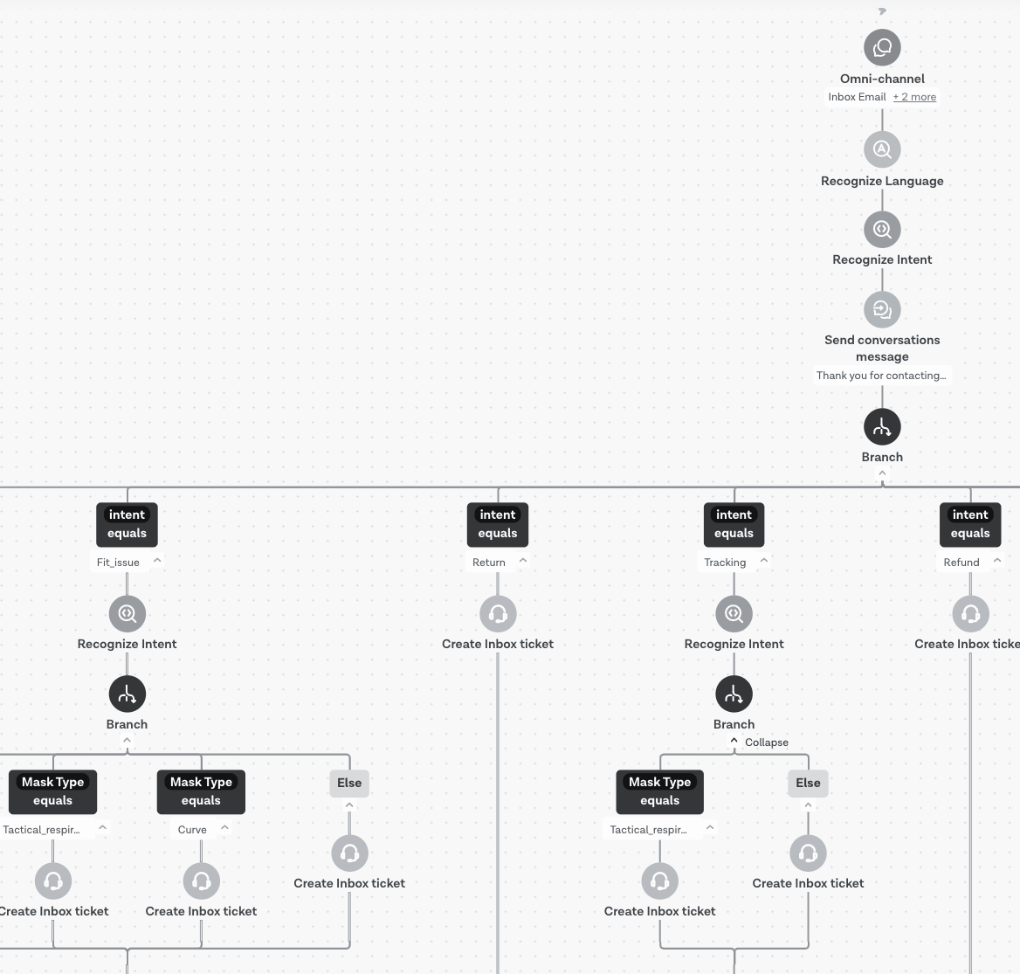
Smart Data Internal Sales Customer Spotlight - Intent
O2 Canada
(MT: #8242459 / MB: #7234892)
Intent-based routing to ensure best matching agent to resolve inquiries faster and more efficiently
Uses complex datasets to sort incoming inquiries
Recognized intents are used to point to Inbox queues and add tags to tickets

Slide 17
Smart Data Internal Sales How to Win - Dominant Use Cases
Routing Optimise cost-per-user for support and improve time-to-resolution
Route messages to the right agent at the right time
Quick-Resolve low-touch or no-touch inquiries from customers
Understand customer satisfaction, loyalty and needs
..and more
Deflection Completely automate recurring processes for your business and reduce operational costs exponentially
Intelligent Virtual Assistants (IVAs) for complete process automation
Qualification of potential customers, fill in the blanks on what a user needs
Registration/Onboarding of users with data and document collection
..and more

Slide 18
Smart Data Internal Sales How to Win? - Getting Customers Started
When use case unknown : Focus on Exploration & Discovery
It’s quite difficult to navigate a conversation around “What are your goals with AI?”. Focus on getting customers to explore benefits.
No technical knowledge required
As simple as building a dataset or copy a sample one and add to flow
Start tracking insights to uncover possibilities
Handful of help center articles, templates and sample datasets
When use case known : Focus on Pilot
Having all building blocks for any conversational AI use case and an outstanding AI engineering team, we can assist customers way better than any other vendor.
Special project for a well-defined problem/goal. Eg.Automate handling claims by processing package pictures to decide damaged goods
We work with customer to build AI flow or logic to achieve the goal
Project wrapped with pilot results and customer training on our AI platform.

Slide 19
Smart Data Internal Sales How to Win? - Target Audience
Sweet Spot
Flow Builder Customers
Inbox & OCW Customers

Slide 20
Smart Data Internal Sales How to Win? - Positioning
Basic Automations Simple add-on to Flows/Inbox for basic deflection such as FAQ, Lead Qualification, Intent-routing
Complex Automations & Operational Excellence Custom journeys superpowered with accessible, easy to use AI platform capabilities
Segment | SMB & Enterprise
Customer Need | Generic Automation, Virtual Assistant connected to existing flow
MB Offer | AI steps in Flow Builder Smart Flow Templates Virtual Assistant Flows Insights & Training
Fees | Add-on for Flow Builder/Inbox Subscription
USP | - Seamlessly automate simple tasks such as FAQ via adding steps to existing flows - Easy management that doesn't require a developer/data analyst
Segment | Enterprise
Customer Need | Business-specific process automation with AI
MB Offer | Professional Services for an Automation project, focusing on deflection & fulfilment - Custom Flow Design - AI setup & Training
Fees | One-time Pilot Fee + Add-on for FB/Inbox Subscription
USP | - In-house ML expertise available for complex automation needs at scale - Ability to work out custom ML models based on real conversations

Slide 21
Available on Slack for any questions or feedback 💌
@fikri.firat
@sebastiaan
#smart-data
#support-data

